Slide 1

E-Learning
Web Development

Slide 2
Submitted By:
Himanshi Agrawal (201500290)
Vishnu Agrawal (201500801)
Subham Yadav (201500709)
Mayank Agrawal (201500392)
Vishal Chauhan (201500791)
Vanshika Verma (201500772)
Under the Guidance of:
Mr. Mandeep Singh (Technical Trainer CSE Department)

Slide 3
Content:
Introduction
Problem Statement
Objective
Technology Used
What is E-Learning
Advantages
Disadvantages
Future
Difference between E-Learning and Traditional Learning
Implementation
Conclusion

Slide 4
Introduction
E-learning is a method of obtaining knowledge through digital or, web-enabled gadgets like computers, laptops, tablets, or smartphones.

Slide 5
Problem Statement
Many people especially in rural areas are not able to migrate to urban areas for higher education due to lack of facilities.
If somehow they are able to do so it consumes their time.

Slide 6
Objective
StarLite allows for an unrestricted freedom to gain access to learnings to anyone willing to expand their skills and knowledge regardless of their age, gender, nationality, and creed.
It is Free Of Cost, which cuts down the expenses for many things that are counted as the utmost requirement in manual learning.

Slide 7
Technology Used (Front-End)
HTML (Hypertext Markup Language) – This is used to design the layout of the website i.e the basic structure of the website is designed with the help of html. It consists of series of elements.
CSS (Cascading Style Sheets) – This is used to add colours, background, styles, animations etc. Basically, this is used for the styling of the website. This describes that how the html elements will be displayed on the website.
JavaScript - This is a high-level language which makes the website interactive for the users. For eg. When it is added to button which was made with the help of html then the javaScript will make that button work.

Slide 8
Technology Used (Back-End)
Firebase-Firebase takes the form of a cloud platform for developing, managing, and running applications. It offers a wide array of tools for accomplishing app development and hosting assignments.

Slide 9
What is Educational Website?
An educational website is a website that was made for education and to research some facts in education especially for students.

Slide 10
Advantages
Flexibility in time.
Variation in course.
Lower cost.
Comfortable learning environment.

Slide 11
Future
65% post-secondary institute providing college level online courses.
Large number of schools from western countries participating.
IBM has tied up with edX platform.

Slide 12
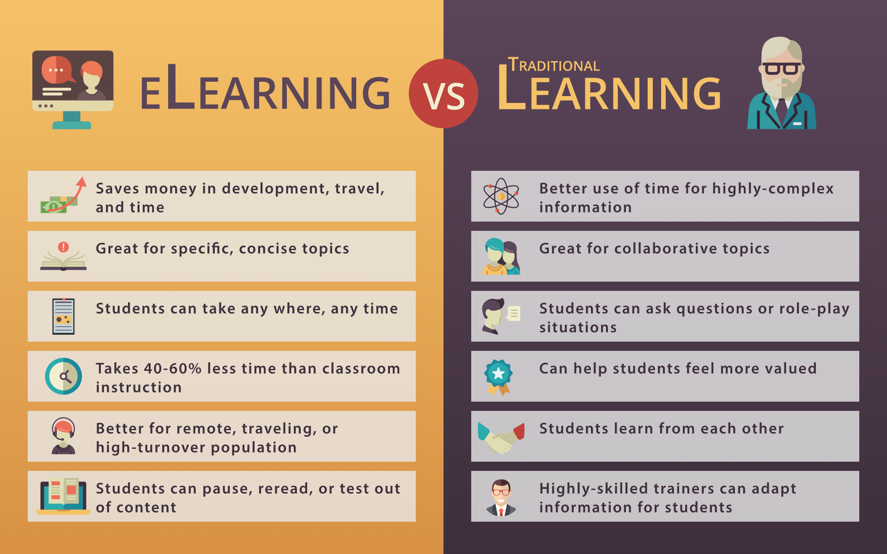

Slide 13
Implementation
We have made a website with all the basic functionalities like about page, home page, internship, coding boot camp, login and sign-up page etc. We have used HTML,CSS,JavaScript as a frontend language to develop the structure of the website and Firebase as a backend.
Furthermore, we have applied certain designs and animations on our website.

Slide 14
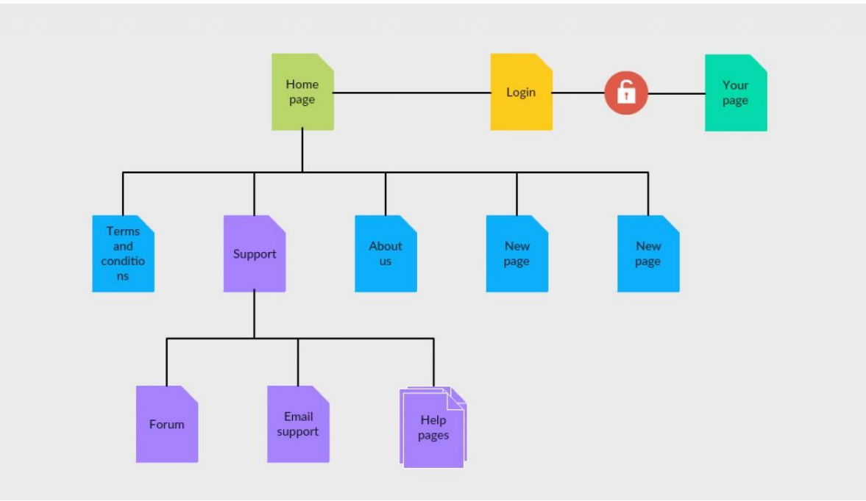

Slide 15

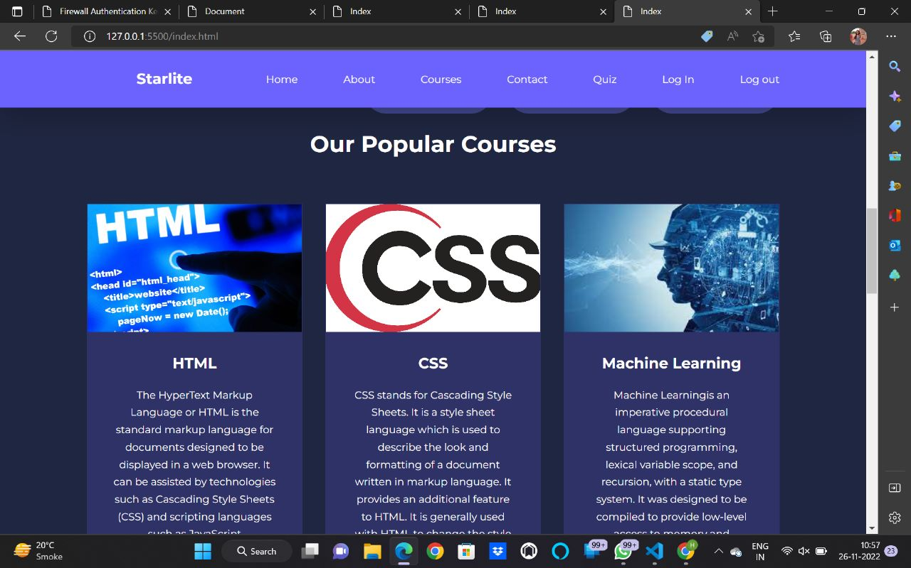
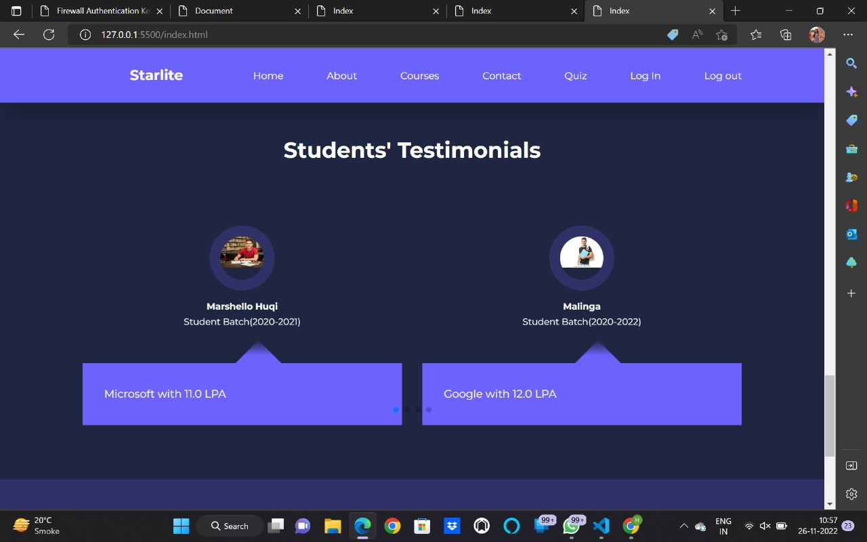
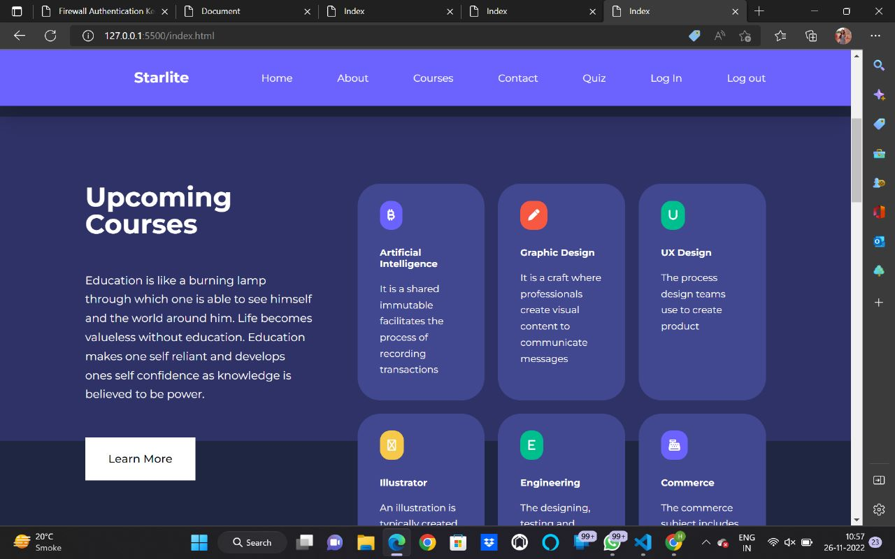
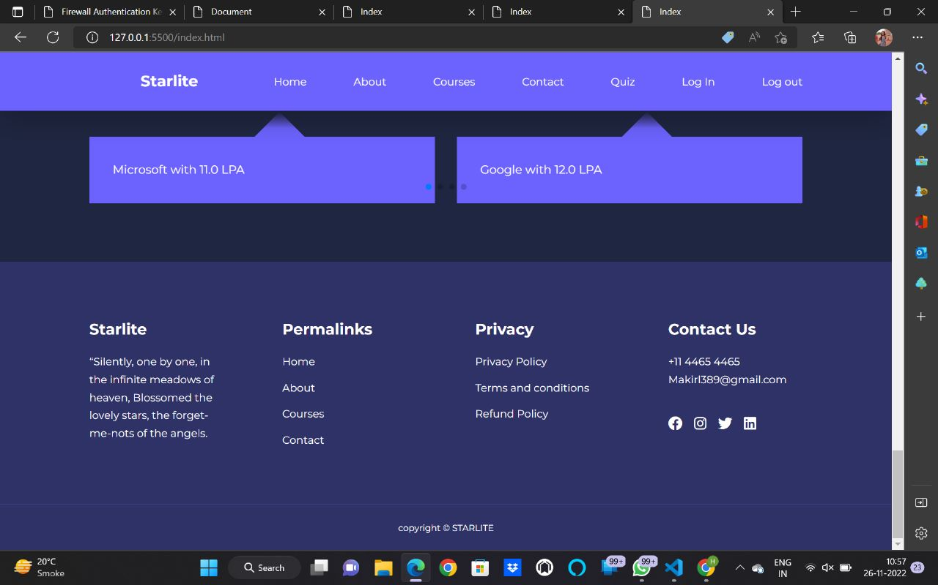
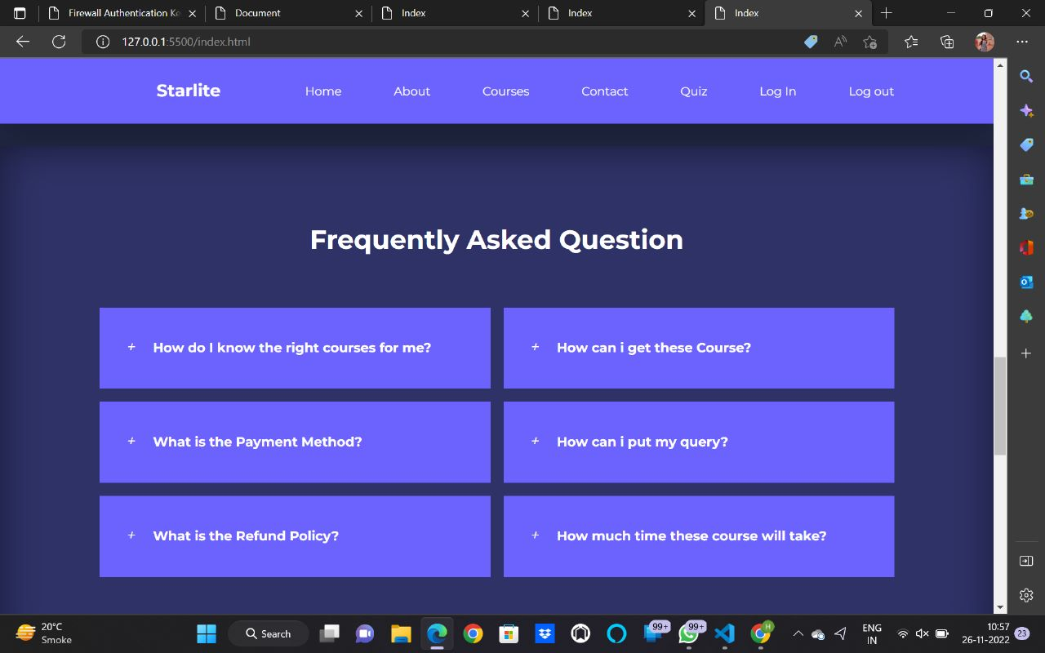
Home Page

Slide 16
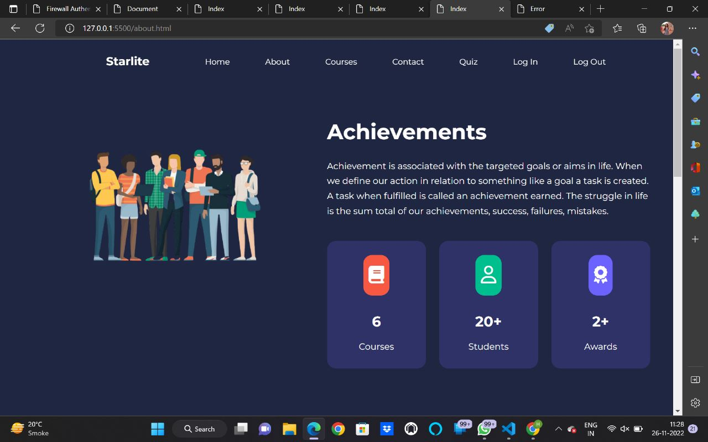
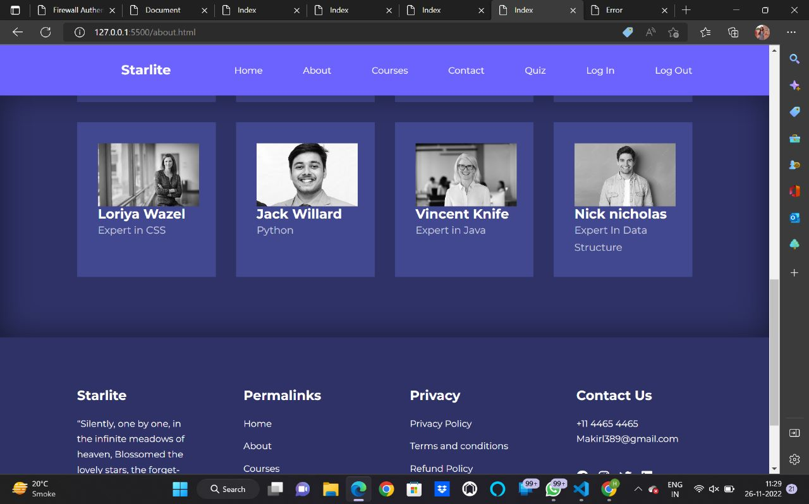
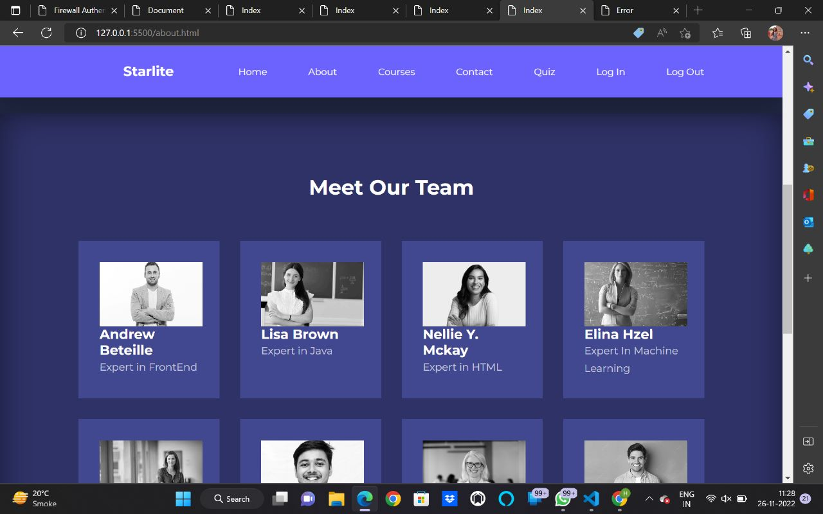
About

Slide 17
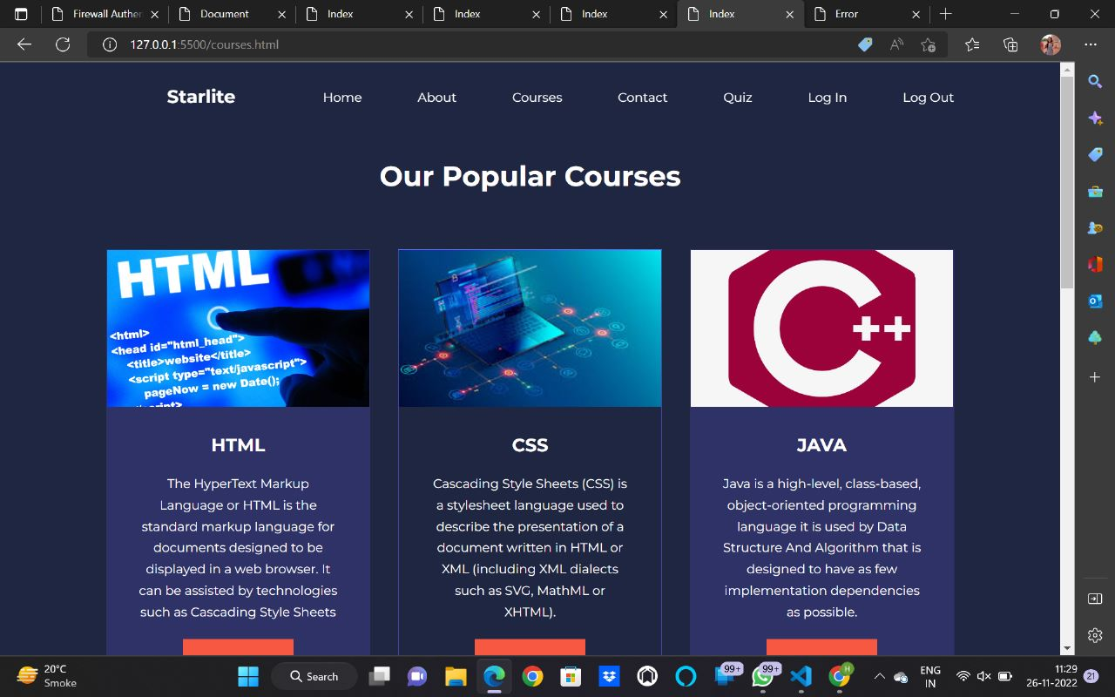
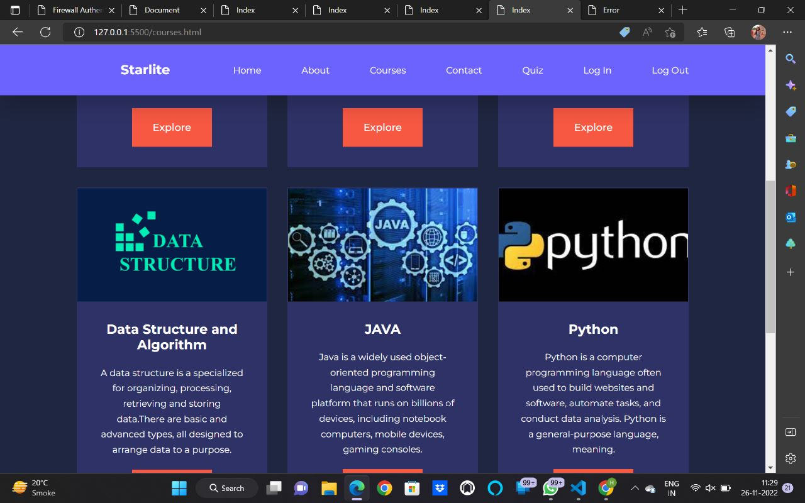
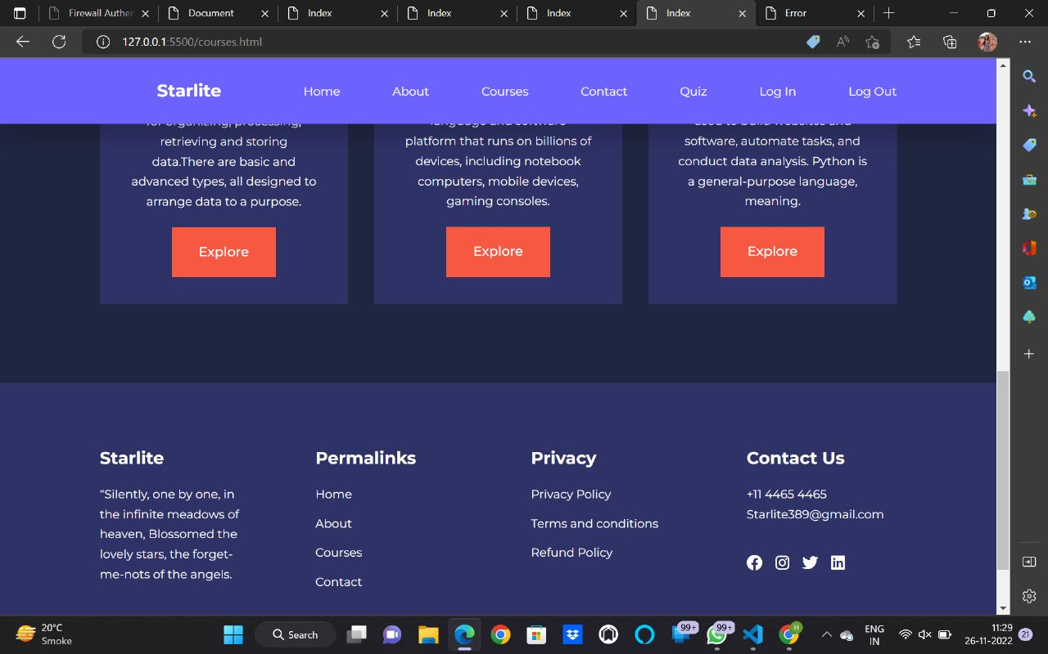
Courses

Slide 18
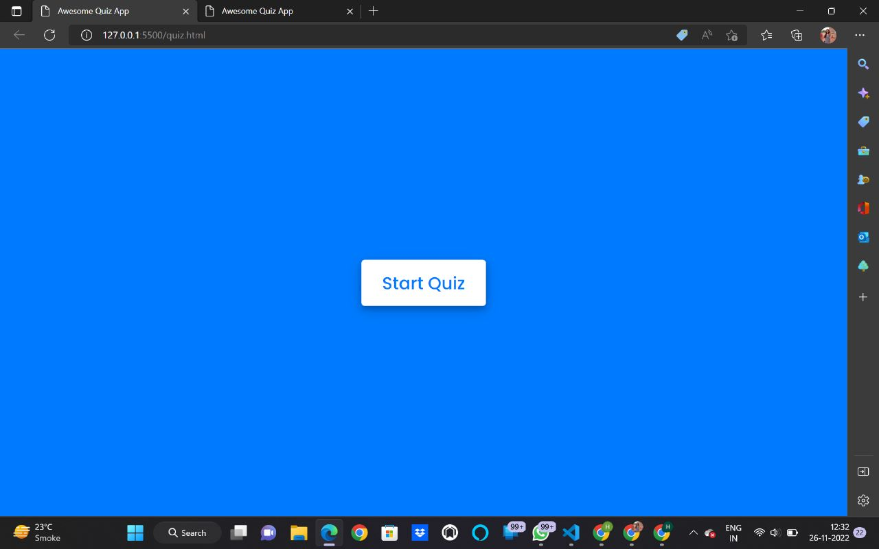
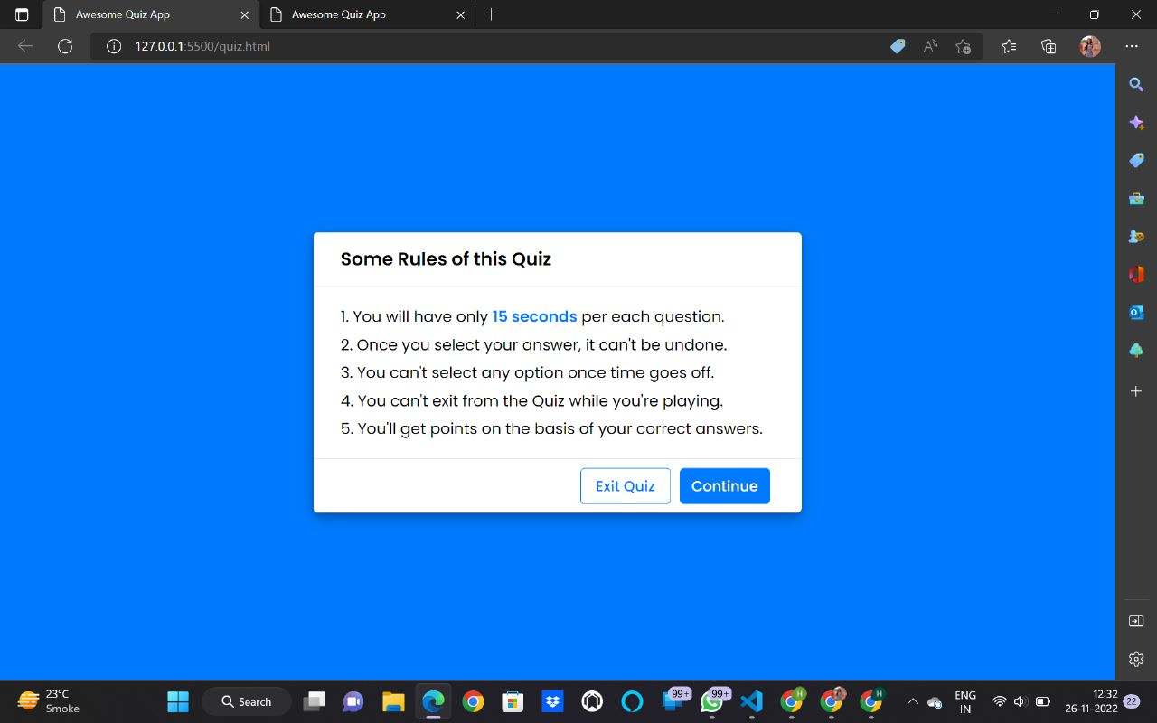
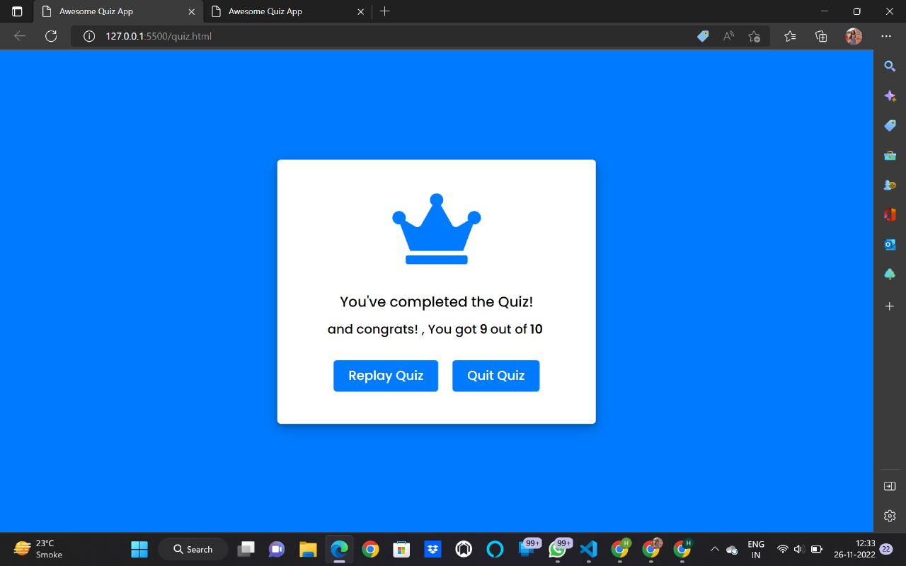
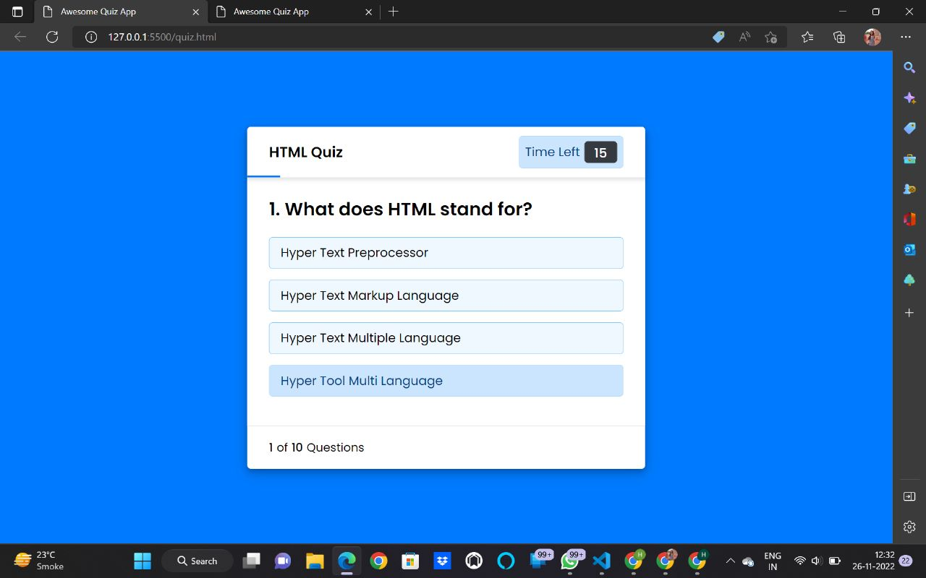
Quiz

Slide 19
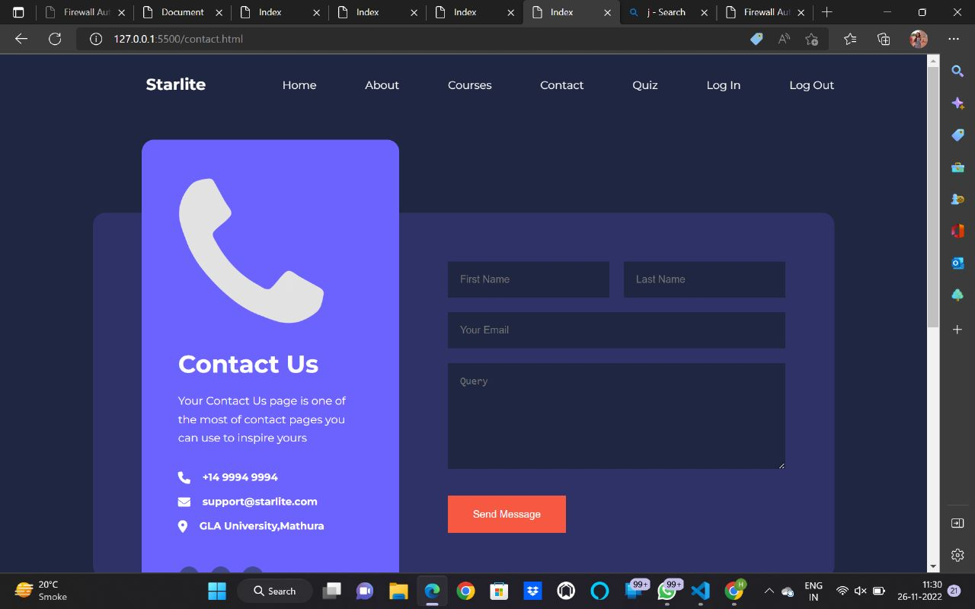
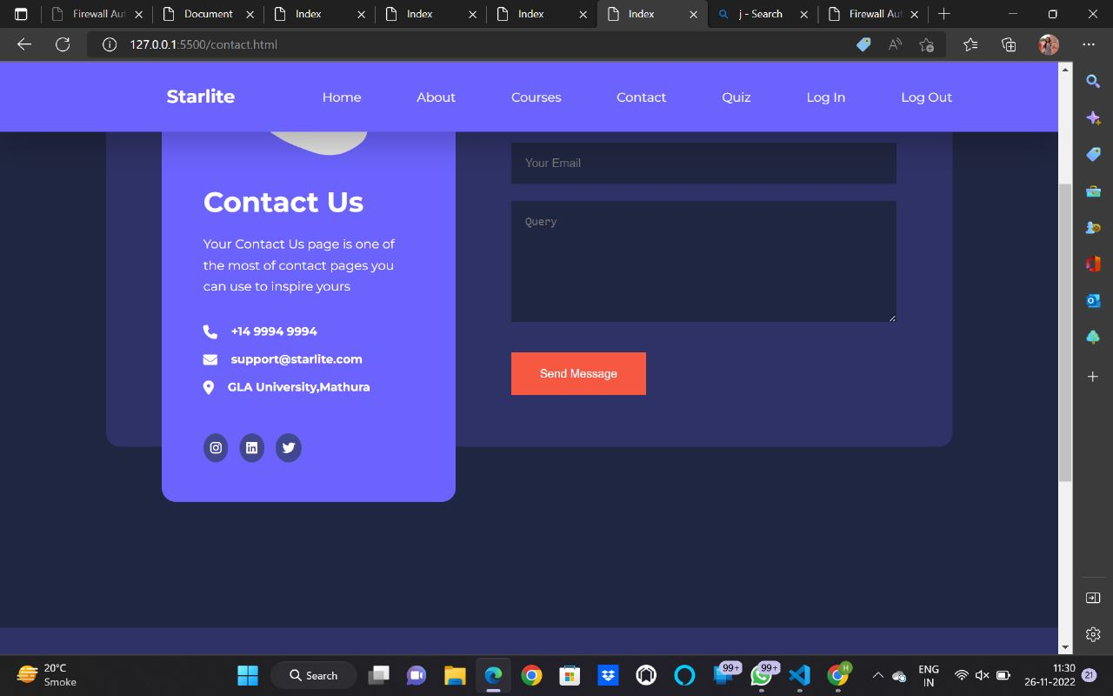
Contacts

Slide 20
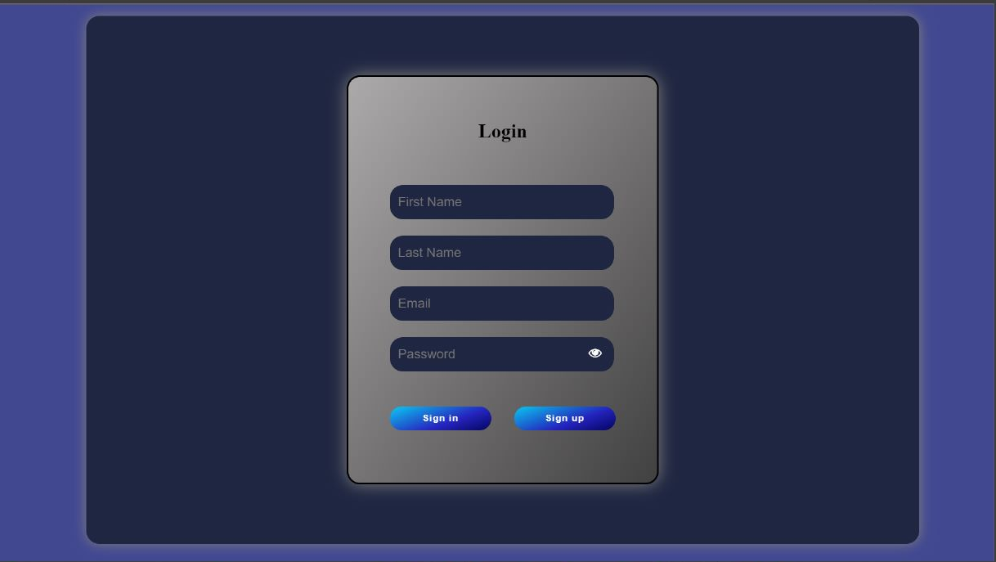
Login

Slide 21
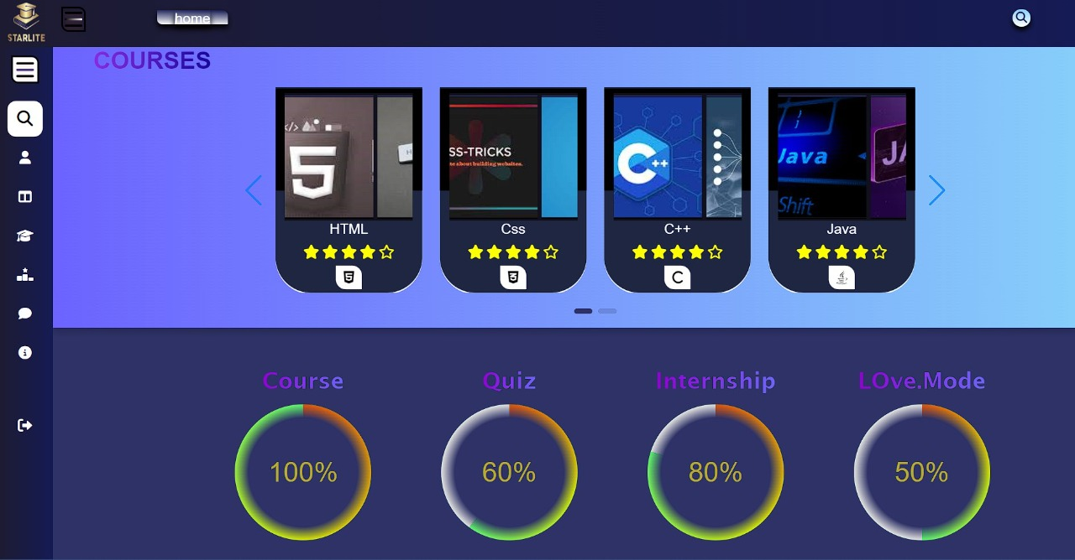
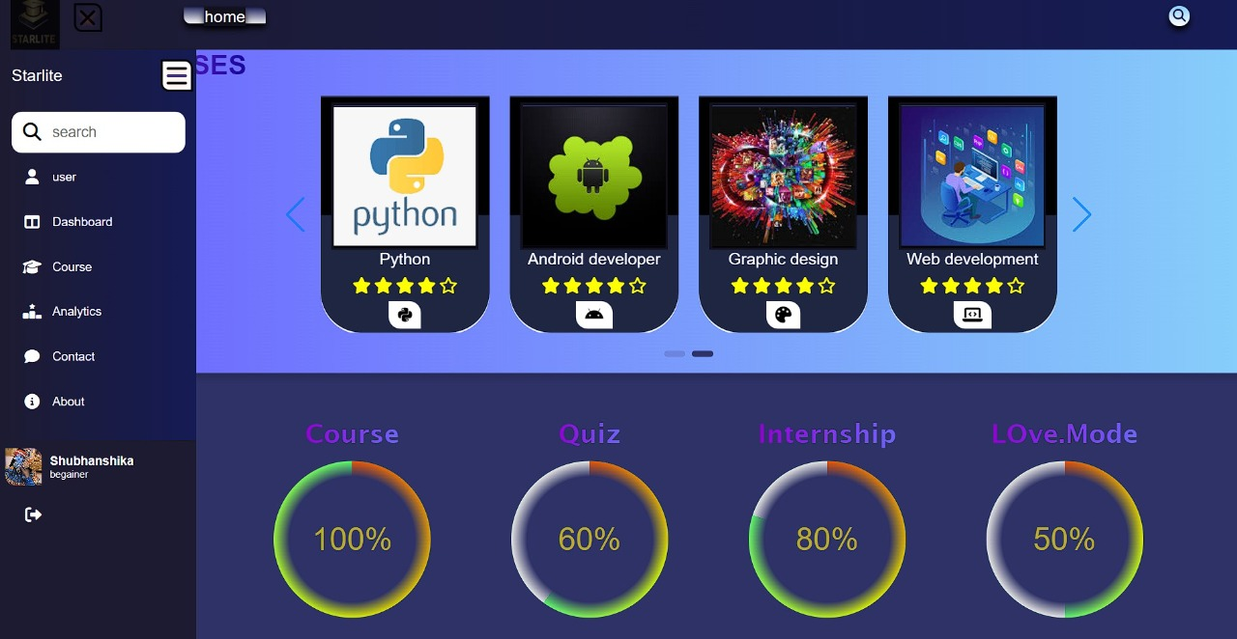
Dashboard

Slide 22
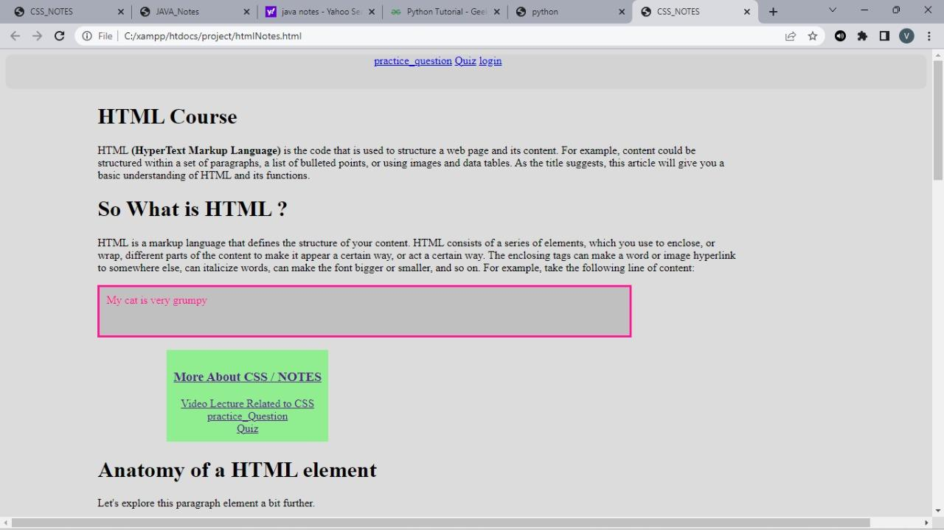
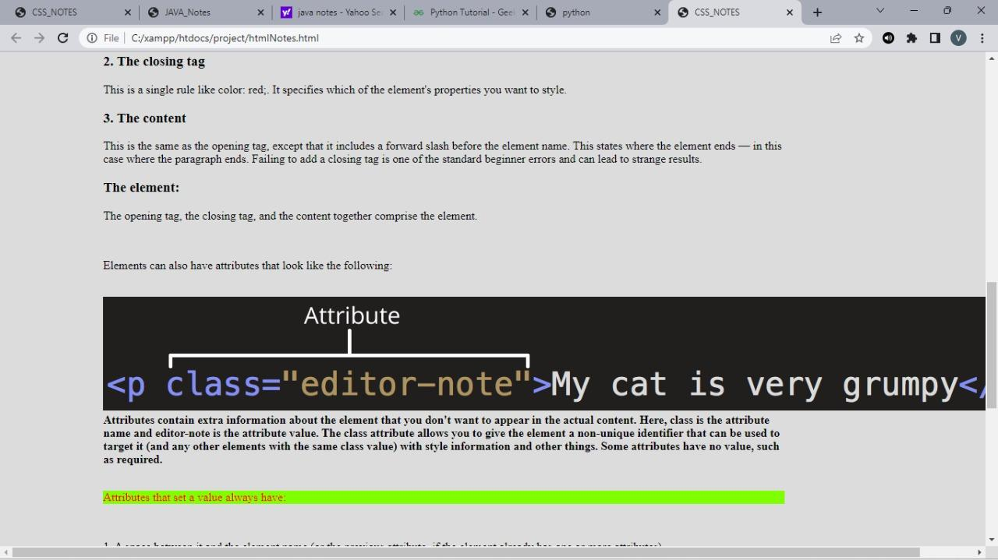
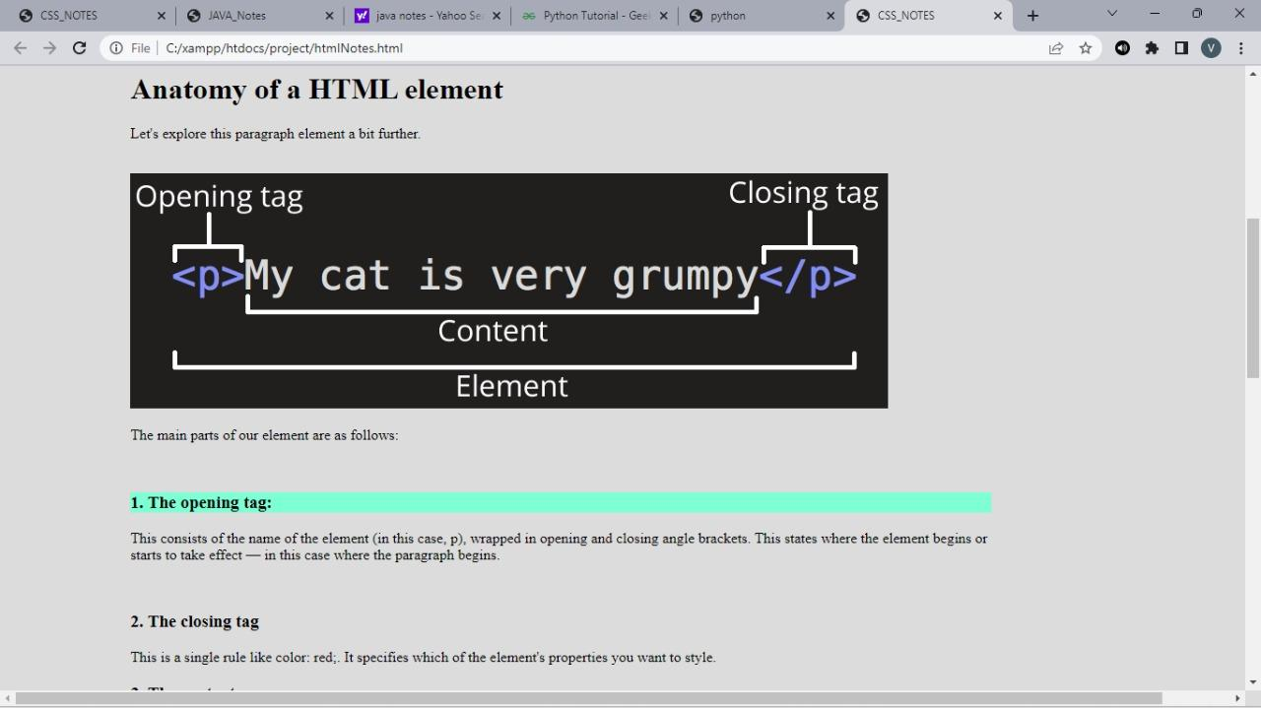
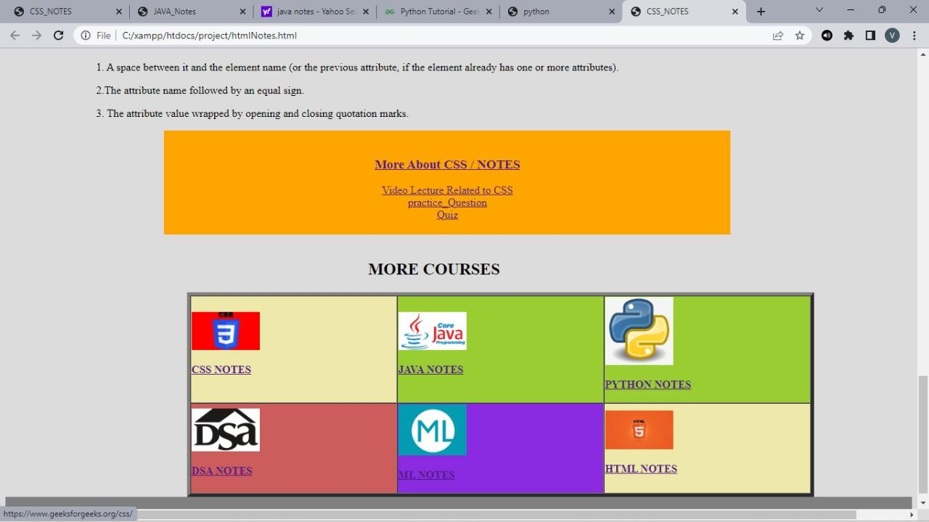
Notes

Slide 23
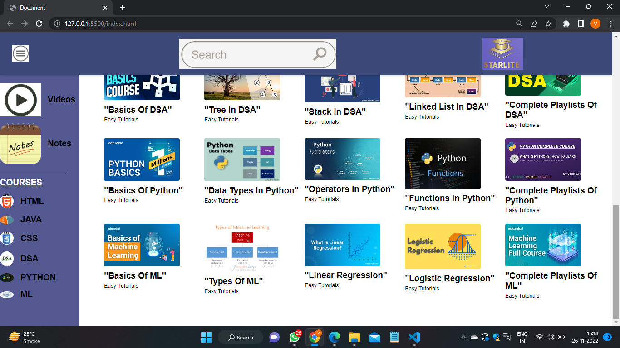
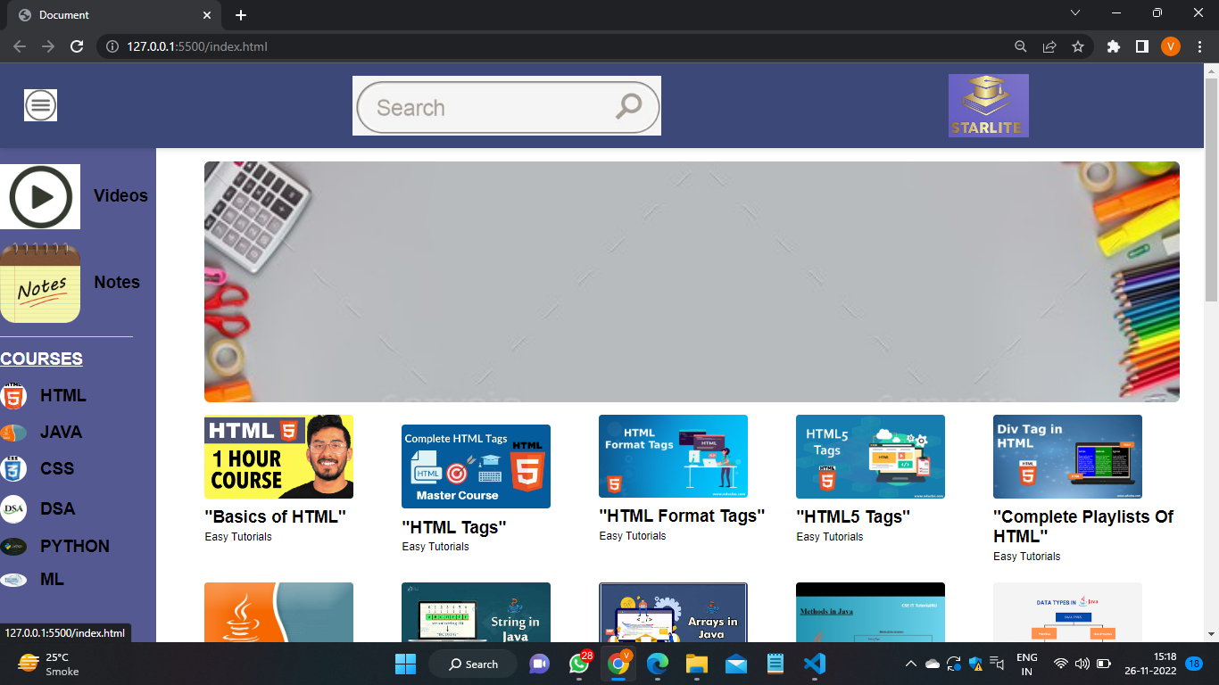
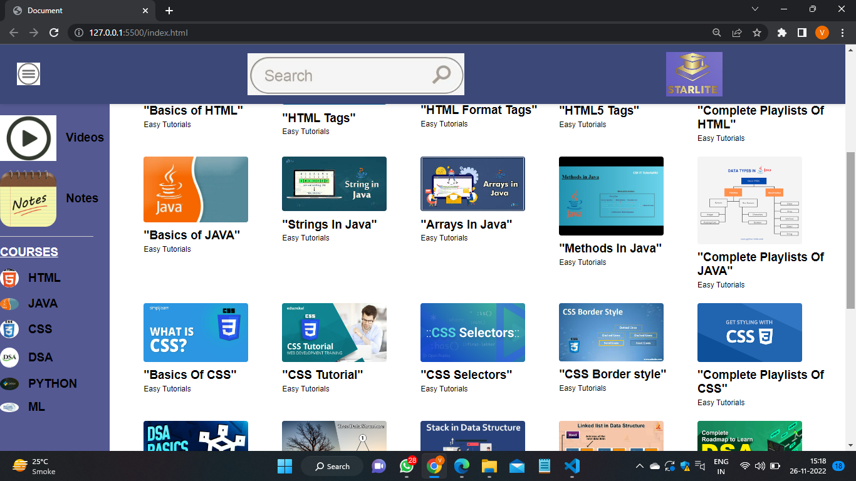
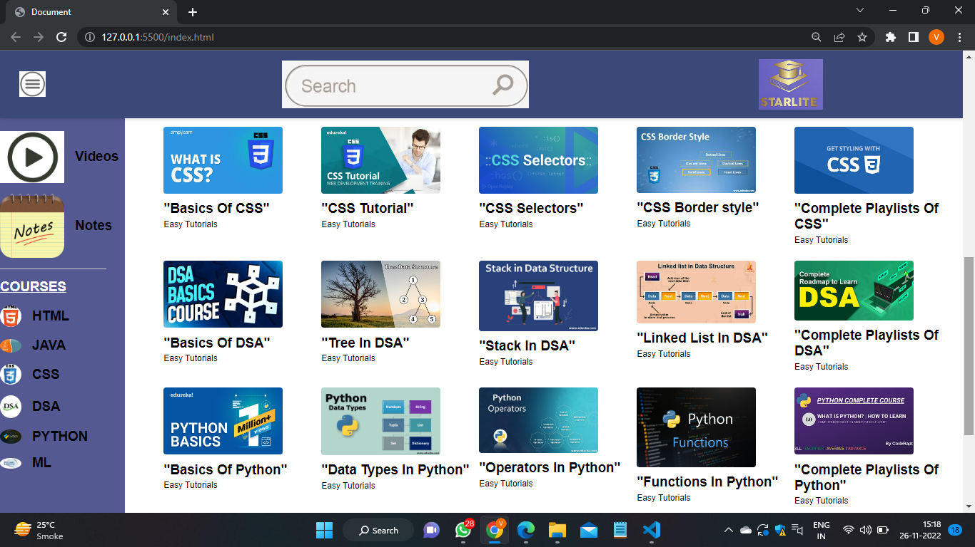
Lecture Videos

Slide 24
Conclusion
We aim to provide a comprehensive environment to become one stop destination for Learning by different courses for college students and help them for their growth. We provide all the necessary study material. There is always room for improvements in any website, however good and efficient it may be. But the most important thing should be flexible to accept further modifications.

